Slide 1

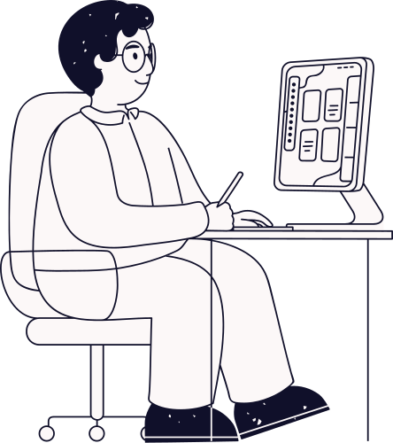


Designing user interface
Best practices in UI/UX
Presented By :
Presented To :
Md. Aayat Hossain Mridha (ID- 2023100000457)
Sumya Akter Asha (ID- 2023100000369)
Umme Ayrin Tithi (ID- 2023100000377)
Shimul Dey Katha
Lecturer, Department of CSE
Southeast University.

Slide 2


Introduction to UI & UX
01
Visual Design Best Practices
02
Principles of Good UI/UX Design
03
Overview
Interaction Design
04
Usability Testing
05
Accessibility & Inclusive Design
06
Current Trends in UI/UX
07
Conclusion
08

Slide 3
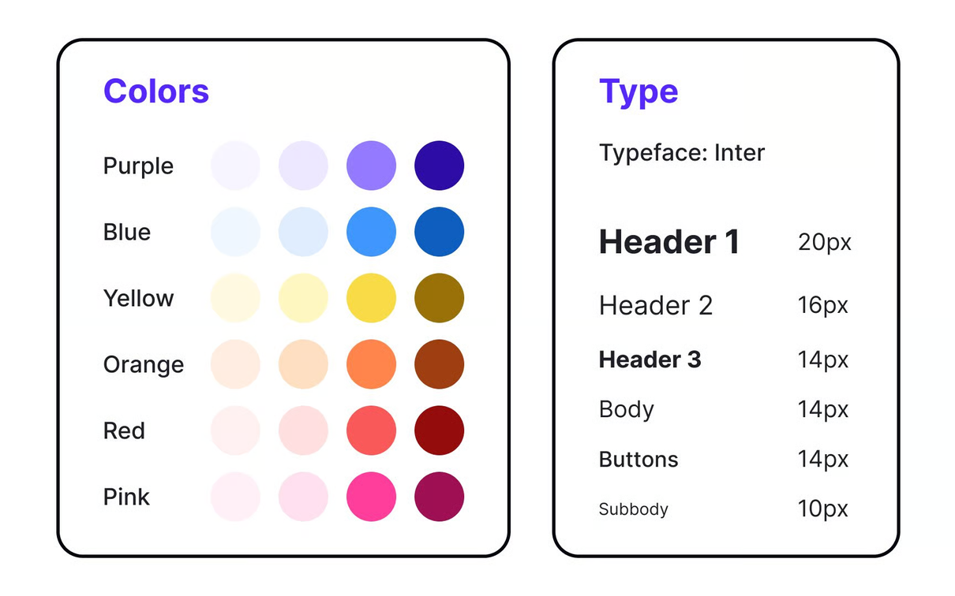

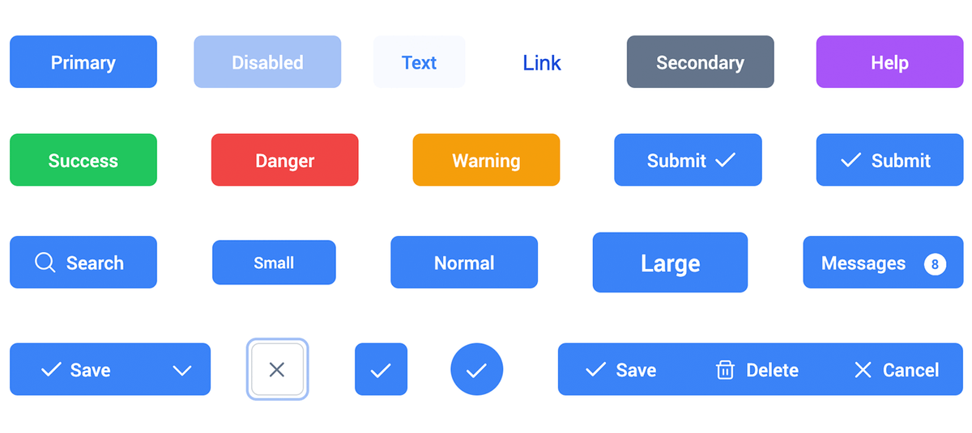


Introduction To UI & UX
User Interface(UI)
Visual elements users interact with
Examples Include – layouts, buttons, colors, typography etc.
Good UI builds trust and engagement

Slide 4

Introduction To UI & UX
User Experience(UX)
Overall feeling and satisfaction a user gets while interacting with a product.
Focuses on usability, accessibility, and efficiency of the entire journey.
Good UX ensures products are easy, enjoyable, and valuable to use.

Slide 5




Principles of UI/UX Design
Seven Fundamental Elements That Shape User Experience
The Essential Pillars of User Interface Design, there are 7 of them

Slide 6

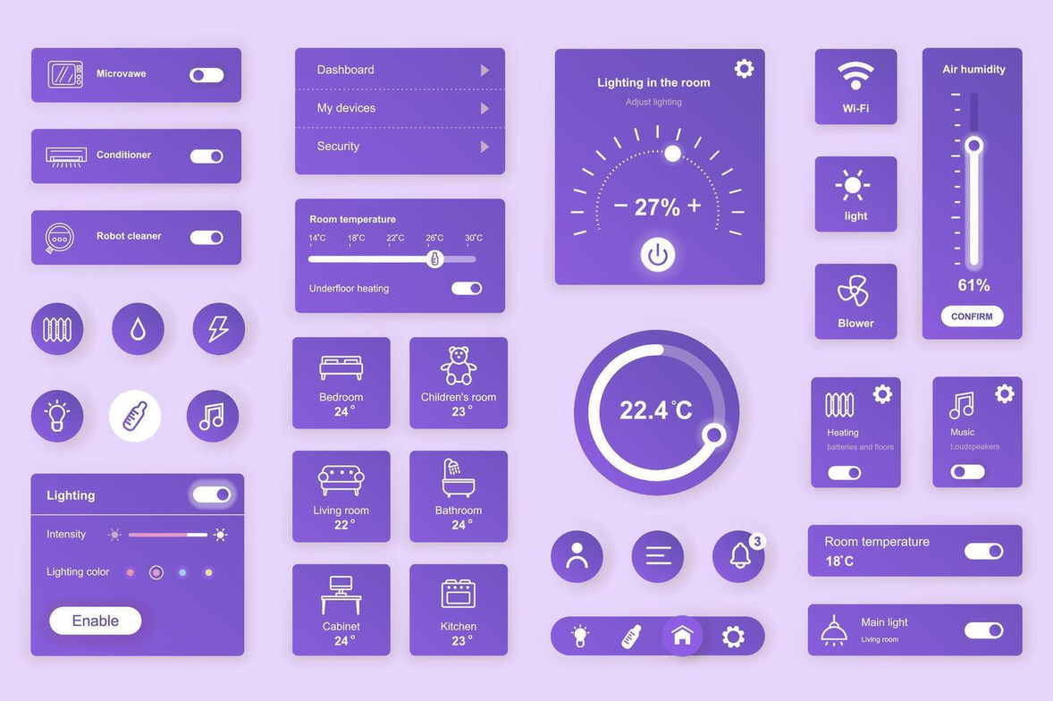
INTERACTION DESIGN.
There are differnt type of interactive elements
BUTTON
LINKS
FORMS
MENU

Slide 7

USABILITY TESTING
Prototypes are early versions of a product that show how it will look and work.
(low fidelity and high-fidelity)
Iterative improvement based on feedback
Feedback is the lifeblood of any successful system. Whether you're designing a loyalty checkout process or fine-tuning a rocket engine feedback provides essential insights

Slide 8


Accessibility & Inclusive Design
Accessibility means making products easy for everyone to use. When designers focus on this, they create apps and experiences that work for all people.
Designing for people with disabilities (WCAG guidelines):
Visual disabilities
Auditory disabilities
Motor disabilities
Cognitive disabilities

Slide 9


Accessibility & Inclusive Design
Keyboard Navigation
Alt Text:
Color Blindness
By following these rules, UI/UX design becomes easier, clearer, and equally usable for everyone

Slide 10

Current Trends in UI/UX
1. Interactive 3D Objects
2. AI interfaces and presence
3. Text & Emoji mix
4. Text transition
etc....

Slide 11


Conclusion
Best Practices in UI/UX means making apps and websites easy and enjoyable for everyone.
Designs should be simple, clear, and work for all users, including those with disabilities. Easy navigation, clear instructions, and helpful feedback make using a product smooth.

Slide 12



Thank You
So Much

